Slide 1
Maintenance Talk
BY TNR REALTORS, LAGOS.

Slide 2

What Is Maintenance

Slide 3
What Is Maintenance?
Maintenance is the combination actions and decisions done to ensure and enforce the upkeep and preservation of property or equipment.
It is what is done to and about an entity to ensure that it functions effectively for as long as possible. It can be carried out on anything, even the body, soul and spirit.

Slide 4

When Is Maintenance?

Slide 5
When is Maintenance?
It should be conceived of even before the entity is possessed, and carried out throughout the entity’s lifespan.
It is a proactive process; you don’t wait till you’re comfortable. It must be done “now”.

Slide 6

Why Maintenance?

Slide 7
Why Maintenance?
To ensure effective functionality.
To foster safety of operations.
To ensure/increase lifespan of entity.
To minimize costs of upkeep.
To promote and ensure aesthetics.
To increase hand-over value.

Slide 8
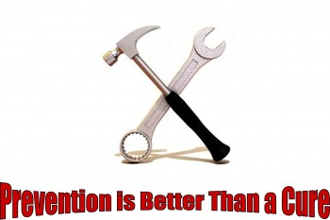
Types Of Maintenance

Slide 9
Types of Maintenance
Reactive Maintenance: waiting for a failure to occur in entity’s functionality before maintenance is done.
Preventive Maintenance: working with manufacturer’s advice to maintain at prescribed time/run-time.
Predictive maintenance: analyzing the entity’s condition to ascertain its being due for maintenance. Employs the use of diagnostic tools for effectiveness, e.g. oil analyzer to determine if oil change is really due.

Slide 10
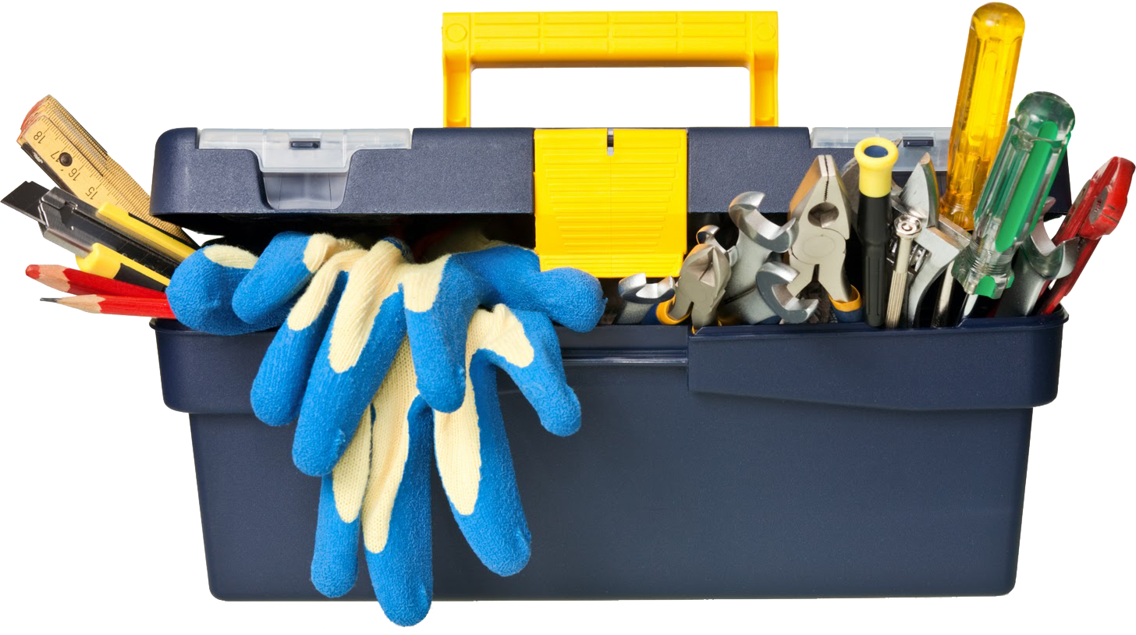
How To Carry out Maintenance.

Slide 11
How to carry out Maintenance
Understand the entity and what the maintenance requirements are before possession. Read the manual, get info, etc.
Analyze the operations, processes and procedures before and during entity’s use.
Plan for maintenance; set time/schedule/make mental notes, buy the needful, seek contacts.
Take action when due. Stop using the entity in the case of reactive maintenance.
Avoid procrastination.

Slide 12
THE END. www.tnrrealtors.com

